Slide 1
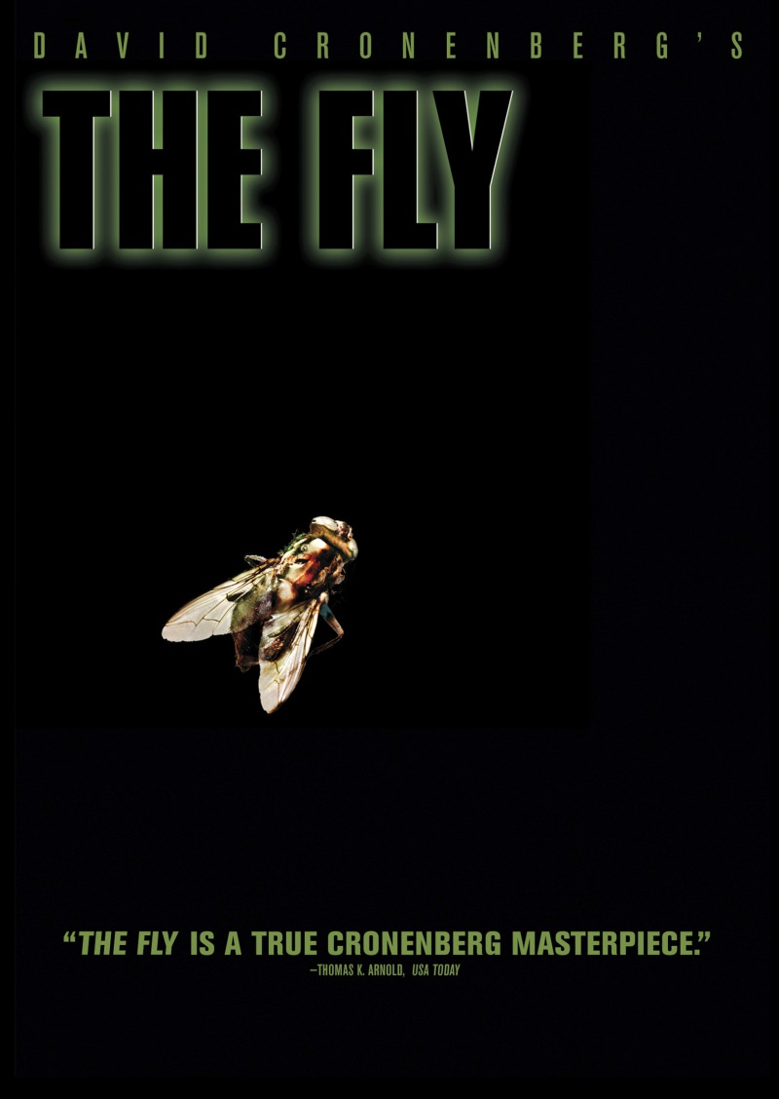
HL8028 – Week 5
David Cronenberg’s
The Fly

Slide 2
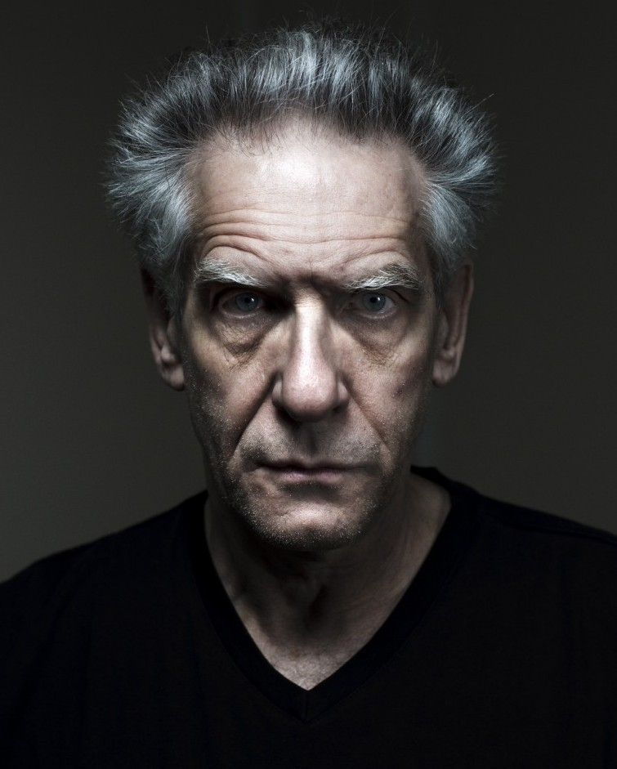
David Cronenberg
Born 1943, Canada
Director, Writer
Films include:
Videodrome
The Dead Zone
Naked Lunch
A History of Violence
Eastern Promises
Cosmopolis

Slide 3
Discussion / Group Work
In what ways does Seth Brundle (of The Fly) lose his humanity? In what ways, if any, does he retain it? What does the film have to tell us about humanity and monstrosity?

Slide 4
Signal Question 1
Cronenberg’s The Fly adopts the classic sci-fi trope of the ‘mad scientist.’ How would you compare Seth Brundle (or “Brundlefly”) with Victor Frankenstein? How does each relate to science and technology?

Slide 5
Signal Question 2
Kafka’s The Metamorphosis and Cronenberg’s The Fly are both about the monstrous transformation of the protagonist. Compare and contrast their transformations, and how they deal with them.

Slide 6
Signal Question 3
What is the role of ‘the abject’ or ‘abjection’ in in The Fly? How is it related to transformation? How does ‘the abject’ differ in this text from Kafka’s The Metamorphosis?

Slide 7
Literature as ‘Symptom’
We often know a disease primarily through its symptoms; itchy skin or sneezing is a symptom of an allergic reaction; phlem and sore throats are not diseases, but symptoms of a disease. Doctors must study the symptoms to figure out the cause.
What if we regard literature as a symptom? We would then have to look at it as a sign, or a cluster of signs; and we would study these signs to figure out what had ‘caused’ them. We could do this psychologically; morally; or culturally/historically.

Slide 8
The AIDS Metaphor
“What makes the 1986 version of The Fly specifically metaphorical for AIDS . . . is its numerous and explicit love-making scenes… and Seth's geometrically increasing sexual appetite as his accidentally transplanted fly genes activate and start to metamorphosize his body. As the protagonist's sexual encounters with his girlfriend increase in length and intensity, subtle symptoms and changes in his body start to emerge that figure the AIDS metaphor as etiology. . . . In a narrative development that evokes public suspicion of promiscuous sexual activity as one of the causes of AIDS, Seth's sexual drive increases to the point of marathon sessions with his exhausted girlfriend, who because of his hypersexuality finally leaves him. Urges unsatisfied, Seth Starts to prowl the rough bars and pick-up spots of the neighborhood."
–Edward Guerrero

Slide 9
The AIDS Metaphor
"At this point, the AIDS analogy fully forms and the slowly materializing symptomatic horror that comes with the realization that something radical is happening to his body overtakes Seth. In a graphic, revealing scene, Seth stands in front of his bathroom mirror and picks off decaying and mutating parts of his body and speculates about his slowly worsening condition being the first signs of a mysterious, agonizing death. In another scene, a frightful projection of the archetypal euphemistic 'singles sex' conversation, Seth calls his girlfriend to warn her that he's afraid that he's 'got something' and that it 'might be contagious.'"

Slide 10
The AIDS Metaphor
"[A]lthough… The Fly (1986) [shows how AIDS] threatens heterosexuals, broadly and sexually active singles in particular, [it] implicitly ratif[ies] the safety and sanctity of the monogamous, ‘traditional’ family.”

Slide 11
The AIDS Metaphor
“When The Fly was released in 1986, there was much conjecture that the disease that Brundle had brought on himself was a metaphor for AIDS. Certainly I understood this… But for me, Brundle’s disease was more fundamental: in an artificially accelerated manner, he was aging. He was a consciousness aware that it was a body that was mortal, and with acute awareness and humor participated in that inevitable transformation that all of us face, if only we live long enough.”
–David Cronenberg

Slide 12
Signal Question
What do you think of this 'reading' of the film (as an AIDS metaphor)? Do you find it compelling? Provocative? Superficial? A stretch? Limited?
In what ways does it make sense to read the film this way? What might such a reading miss?

Slide 13
Cohen’s Seven Theses
The Monster’s Body Is a Cultural Body
The Monster Always Escapes
The Monster is the Harbinger of Category Crisis
The Monster Dwells at the Gates of Difference
The Monster Polices the Borders of the Possible
Fear of the Monster is Really a Kind of Desire
The Monster Stands at the Threshold… of Becoming

